Slide 1
I21456 INTERNSHIP
PSG POLYTECHNIC COLLEGE
INFORMATION TECHNOLOGY
VIRTUALIZATION
FACULTY GUIDE: Mrs. A.HARITHA DEEPTHI
BY,
ABHIJITHA
KIRAN
LAKSHMANDEV
RAJARAJAN
BATCH - 7

Slide 2

ABOUT THE COMPANY
CRAPER SOFT is a newly developed Global Technology Development Corporation, building the new technical skilled manpower for global industry requirements. The company which was set up in 2015 and we are ISO 9001:2015 certified company.

Slide 3
CONTENTS
01.
02.
03.
INTRODUCTION
TYPES
BENEFITS
04.
06.
TOOLS
OUR PROJECT
Introduction about Virtualization
Types of Virtualization
Benefits of Virtualization
Management and tools of Virtualization
Project on Virtualization

Slide 4
01.
INTRODUCTION
Introduction about Virtualization
BY
LAKSHMANDEV

Slide 5
Introduction
Virtualization is the technology that allows the creation of virtual environments or machines within a physical infrastructure, providing benefits such as resource optimization, flexibility, security, and efficient management of computing resources. It enables the abstraction and isolation of software from the underlying hardware, revolutionizing the way IT infrastructure is utilized and managed

Slide 6
DEFINITION
Virtualization is the creation of virtual instances that mimic physical computing resources, enabling efficient utilization, flexibility, and simplified management of IT infrastructure.

Slide 7
02.
TYPES OF VIRTUALIZATION
Types of Virtualization
BY
ABHIJITHA

Slide 8
Types
Full-virtualization
Para-virtualization
OS-level virtualization
Microsoft and Parallels systems are examples of full virtualization.
VMware and Xen are some examples of paravirtualization.
Linux-VServer, Parallels Virtuozzo Containers some examples of os-level virtualization

Slide 9
Full-Virtualization
Full Virtualization was introduced by IBM in the year 1966. It is the first software solution for server virtualization and uses binary translation and direct approach techniques. In full virtualization, the guest OS is completely isolated by the virtual machine from the virtualization layer and hardware. Microsoft and Parallels systems are examples of full virtualization.

Slide 10
Para-Virtualization
Paravirtualization is the category of CPU virtualization that uses hypercells for operations to handle instructions at compile time. In paravirtualization, guest OS is not completely isolated but it is partially isolated by the virtual machine from the virtualization layer and hardware. VMware and Xen are some examples of paravirtualization.

Slide 11
OS level-Virtualization
OS virtualization is the use of software to allow a piece of hardware to run multiple operating system images at the same time. The technology got its start on mainframes decades ago, allowing administrators to avoid wasting expensive processing power.

Slide 12
03.
BENEFITS
Benefits of Virtualization
BY
KIRAN

Slide 13
BENEFITS
BENEFITS
Resource Optimization
Cost Reduction
CC ENABLEMENT
Virtualization maximizes resource utilization by running multiple virtual machines on a single physical server, leading to cost savings and increased efficiency.
Virtualization reduces costs by consolidating servers and minimizing hardware and operational expenses. It streamlines management, reducing administrative overhead and labor costs.
Virtualization is crucial for cloud computing, enabling scalable resource delivery and efficient sharing of infrastructure.

Slide 14
04.
TOOLS
Management and tools of Virtualization
BY
RAJARAJAN

Slide 15
Tools in Virtualization
SCVMM
Proxmox VE
SCVMM is a Microsoft Hyper-V virtualization platform management tool. It offers centralized management of virtual machines, virtual networking, and storage.
Proxmox VE is an open-source virtualization management platform that combines KVM and LXC containerization. It provides a web-based management

Slide 16


VMware vSphere
Citrix XenCenter
VMware vSphere is a powerful virtualization platform for data centers, offering robust tools for managing and deploying virtual machines.
XenCenter is a management console for Citrix XenServer, an open-source virtualization platform. It provides a user-friendly interface to manage virtual machines, storage, and networking resources.

Slide 17
Our Project
Drag and Drop & Virtual Steering
05.
BY
LAKSHMANDEV

Slide 18
Drag & Drop
Project 01
By
Python 3.10.11
By
Python 3.10.11

Slide 19

Drop & Drop
My Project on virtualization is a Python program that makes an object drag and drop through hand gestures by handling the camera portion.

Slide 20
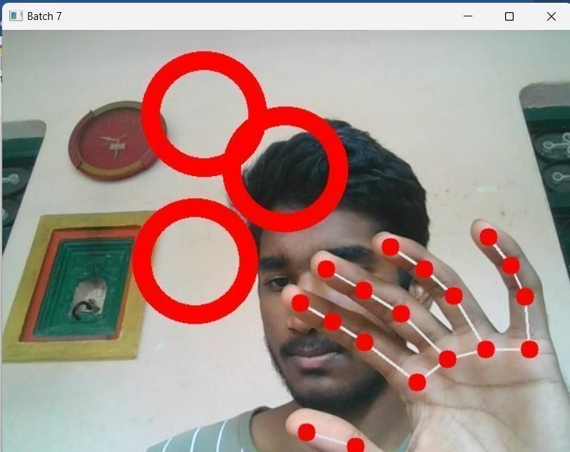
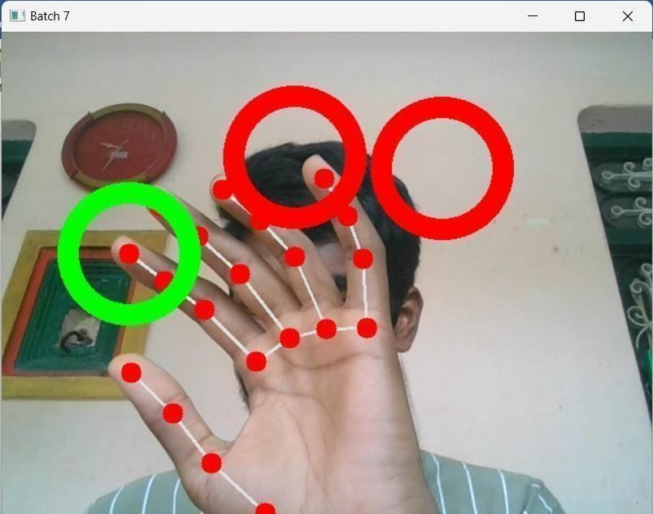
OUTPUTS

Slide 21
VIRTUAL STEERING
Project 02
By
Python 3.10.11

Slide 22

Virtual Steering
Virtual steering refers to the simulation of steering a vehicle in a digital or virtual environment, typically using input devices and software to replicate the experience. It is commonly used in video games, virtual reality simulations, and driving training programs to provide users with an immersive and realistic driving experience

Slide 23
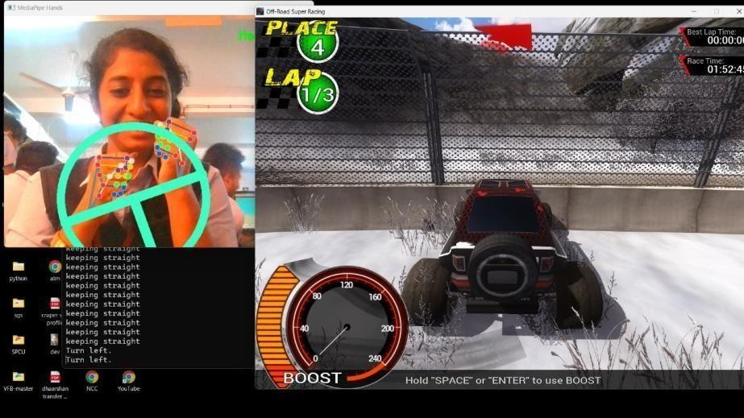
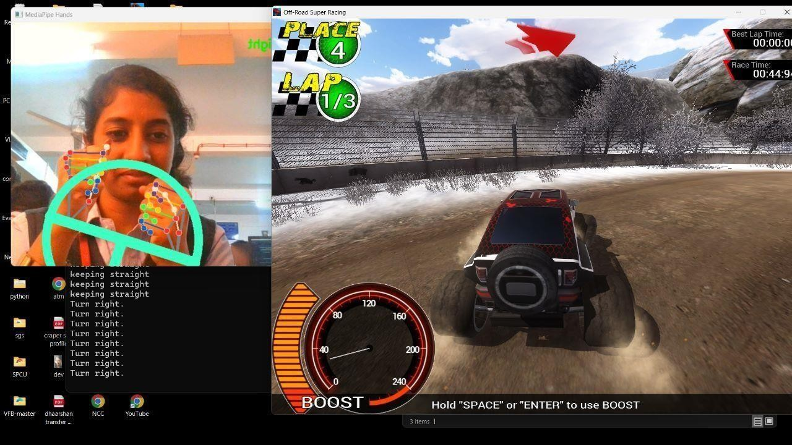
OUTPUTS

Slide 24
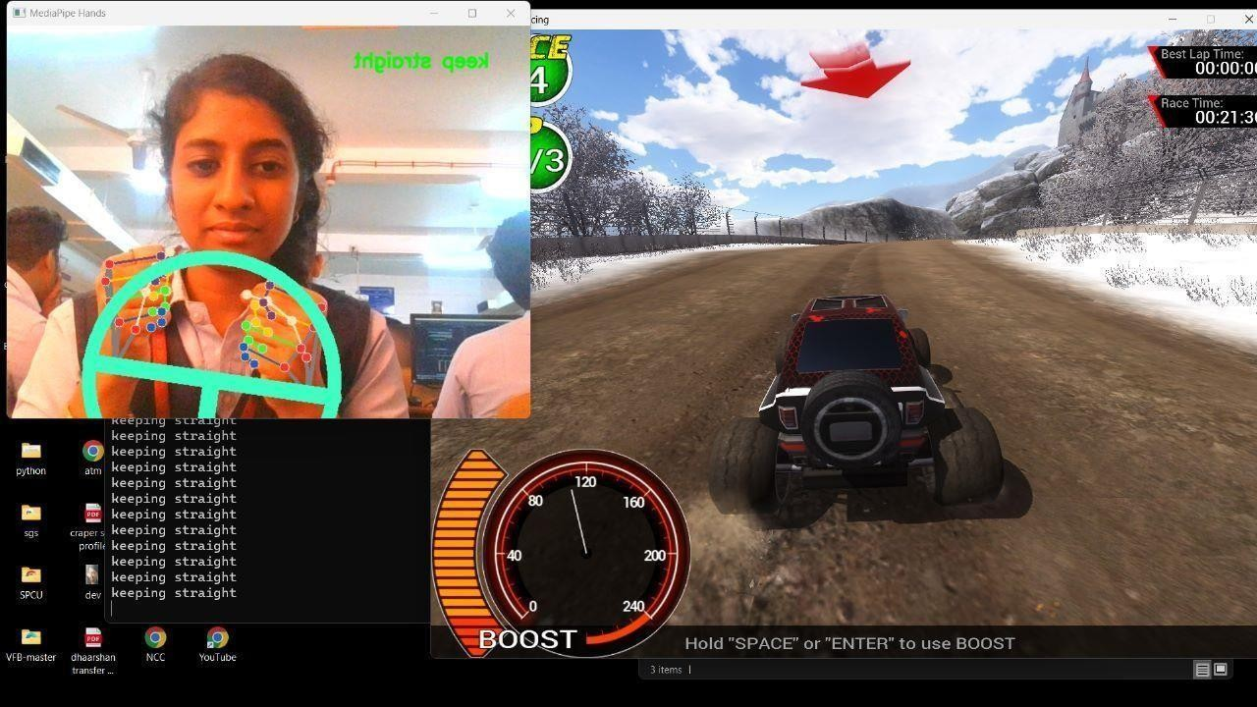
OUTPUTS

Slide 25
THANK YOU

